Slide 1

General Introduction to Choice Modeling
Chandra R. Bhat
University of Texas at Austin
Notes:
My name is Chandra Bhat. I am the Director of the Center for Transportation Research at the University of Texas at Austin. Welcome to this series of videos on choice modeling. In this first in the series of voice over slides videos, I will introduce choice modeling rather broadly. Subsequent videos will go into additional and specific details.

Slide 2

Introduction: Choice Modeling
A set of tools to predict the choice behavior of a group of decision-makers in a specific choice context.
Notes:
In general, choice modeling refers to a set of tools to predict the choice behavior of a group of decision-makers in a specific choice context. As we will see shortly, the decision-maker may be an individual, a household, a shipper, an organization, or some other decision making entity. At a fundamental level, choice modeling allows us to determine the relative influence of different attributes of alternatives and characteristics of decision makers when they make choice decisions.

Slide 3

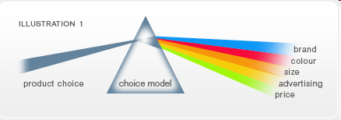
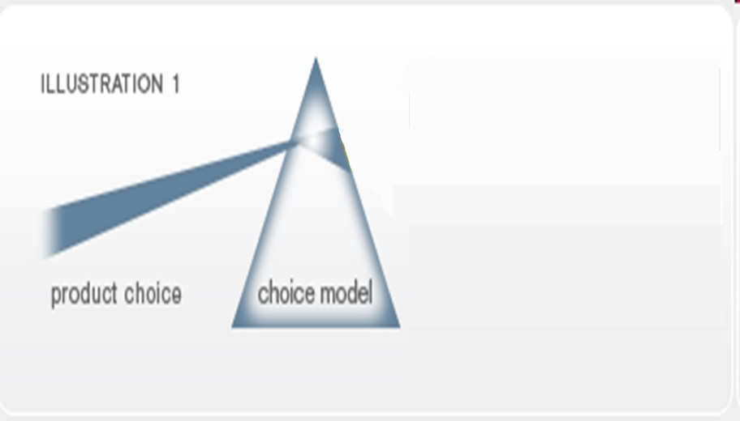
Picture Reference: Future and Simple-Choice Modeling (by Steve Cook and Michael McGee)
http://www.futureandsimple.com/research/choicemodelling/what-is-choice-modelling.html
Notes:
To get a better appreciation of what I mean, I will present a somewhat imperfect, but easy-to-understand, analogy developed by Steve Cook and Michael McGee. Consider that we observe a product choice made by an individual as well as the features of the many products from which the individual chooses the particular product. The features of the many products from which the individual chose the product may include brand name, color, size, advertising, and price. Think of the product choice along with all the features of the products as being a white beam of light that shines onto a transparent glass prism that represents a choice model. Then, the Choice Model, like a clear prism refracting a white beam of light into its component spectrum, will identify the ‘value’ of each component feature manifested in the multi-dimensional feature set represented in the products. More specifically, given the product choice made by an individual from a set of available products, the goal of the estimation phase of choice modeling is to infer how much the individual values each of several features of a product.

Slide 4

Picture Reference: Future and Simple-Choice Modeling (by Steve Cook and Michael McGee)
http://www.futureandsimple.com/research/choicemodelling/what-is-choice-modelling.html
Notes:
In application, we then use the choice model to combine the valuation of an individual to specified features of a product to predict whether the individual will purchase the product from a wider choice set of products. We will return later again to this concept of application of choice models at the individual-level. Of course, when applied across individuals in the population, the individual-level choice predictions translate to a market share for each product in the market place.

Slide 5
Discrete Choice Models
Discrete choice models can be used to understand and predict a decision maker’s choice of one discrete alternative from a choice set.
Notes:
To summarize, discrete choice models can be used to understand and predict a decision maker’s choice of one discrete alternative from a choice set of alternatives. Such models have numerous applications because many behavioral responses are discrete or qualitative in nature. Indeed, discrete choice models are used in many fields.

Slide 6
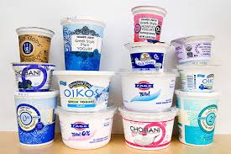

Marketing
Consumer brand choice (Yogurt purchases)
Notes:
In marketing, consumer brand choice is a ubiquitous context for analysis. For example, yoghurt manufacturers and packagers may be interested in what features of their yoghurt, in terms of texture, fat-free or regular, package size, shelving and advertising actions, cost, and even simply the brand name affect consumer choices.

Slide 7
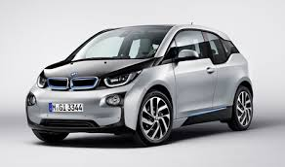
Marketing
Consumer product development
Notes:
Another example in marketing would be in consumer product development, such as in the design of an electric car. What features would be important to consumers? Which population segment is most likely to buy? What is the interplay between the product features and who might buy, and how do I strategize to increase the acceptance of my new product?

Slide 8
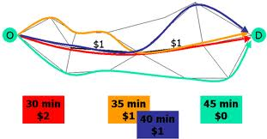

Transportation
How pricing affects route choice
How much is a driver willing to pay
Notes:
In the transportation field, analysts and policy-makers may want to know how pricing affects route choice. Different routes may entail different travel times, travel time reliabilities, and costs, among other characteristics. The analyst may then be interested in knowing whether a driver will select a planned new toll roadway or a current roadway with a new pricing scheme. This has implications for the level of travel time and travel time reliability changes on the priced route and other non-priced routes, as well as for the potential revenues generated. Of interest is also the design of the pricing scheme. Or this can be turned around to ask how much is a driver willing to pay to reduce travel time and increase reliability?

Slide 9




Energy Economics
Notes:
As indicated earlier, the decision maker may not always be an individual consumer. In the field of energy economics, a choice context of interest may be how a city decides on investing its resources to generate more energy. Should the city invest in conventional power grid systems, or in solar power, or in wind energy infrastructure. This choice is likely to be affected by the profile of consumers residing in the city, the current infrastructure in the city, and the cost and possible benefits of each type of energy source investment. Another point to note here is that the city may actually invest in a combination of different energy sources and to different extents, which can be analyzed through what are now referred to as multiple discrete choice models. However, unless otherwise stated, the focus of the early parts of the video course at the site will be on decision agents choosing one alternative from a set of mutually exclusive alternatives.

Slide 10

Environmental Economics
An Angler’s choice of fishing site
Notes:
Another choice phenomenon of interest, but now in the environmental economics field, is an angler’s choice of fishing site, which may be a function of travel cost to the site, any fees at the site, the quality of the water at the site, the variety of fishes at the site, and other aspects of the site and of the angler. In this context, welfare measurement may focus on the result of closing a site or on improving water quality at a site.

Slide 11

Geography
Firm location decisions
Notes:
In geography, an important choice phenomenon that has been modeled is firm location decisions. Here, the firm is the decision maker. The firm’s decision may be based on other similar firms located in the area, other complementary types of firms, the cost of doing business in a location, the availability of talent pool, and accessibility to markets.

Slide 12
Example: Daily activity-travel pattern of an individual
7:30 am
7:35 am
walk
drive
drive
Kid’s School
8:00 am
12:30 pm
7:15 am
12:35 pm
Work
Restaurant
Home
5:00 pm
1:05 pm
6:30 pm
1:00 pm
drive
walk
drive
6:00 pm
5:30 pm
Shop
Notes:
Of course, choice models are used extensively in activity-based travel forecasting platforms. As a simple example, consider the daily activity pattern of a working individual with a child in the household. There are several choice decisions embedded in the individual’s activity-travel pattern illustrated here, including the work timings of the individual, which, in the illustration is from 8 am to 5 pm, whether the person will drive her or his child to school in the morning, if so, the departure time from home, whether or not the person will make a stop at a restaurant during the midday, the departure time from work if there is a stop during the mid-day, and so on.

Slide 13
Application
Use understanding to…
Forecast choices and market shares
Influence choices
Inform policy analysis
Notes:
Well, we have seen many examples of choices in different fields. But now, I would like to come back to the application of choice models. There are at least three aspects to the application of choice models, once they are estimated based on observed choice data. The first is to forecast choices and market shares into the future, because of changing demographic characteristics of consumers and alternative attributes. For example, the aging of the US population can have impacts on the mode and activity participation choices of individuals. The second is to proactively influence choice behavior rather than use choice models simply as a reactive tool. For instance, if a choice model indicates that mixed land-use encourages walking and bicycling, then a development strategy to proactively increase walking and bicycling would be to promote land-use mixing. The third is to inform policy analysis to decide whether to invest in a certain capital investment or not. For instance, in the transportation field, a new bus rapid transit system may provide overall welfare value that has to be compared to its cost. Similarly, in environmental economics, the degradation caused by an oil spill to water quality leads to a loss in value to anglers because of a deterioration in the quantity and diversity of fishes, and assessing this environmental harm is an important component of legal action against the polluter.
Well, that’s it for this introductory video on choice modeling. Have fun with the rest of the videos. Cheers.

Slide 14
Elements of Choice Decision Process
Decision maker
Alternatives
Attributes of alternatives
Decision rule
Notes:
We observe individuals (or decision makers) making choices in a wide variety of decision
contexts. However, we generally do not have information about the process individuals use to
arrive at their observed choice. A proposed framework for the choice process is that an
individual first determines the available alternatives; next, evaluates the attributes of each
alternative relevant to the choice under consideration; and then, uses a decision rule to select an
alternative from among the available alternatives (Ben-Akiva and Lerman, 1985, Chapter 3).
Some individuals might select a particular alternative without going through the structured
process presented above. For example, an individual might decide to buy a car of the same make
and model as a friend because the friend is happy with the car or is a car expert. Or an individual
might purchase the same brand of ice cream out of habit. However, even in these cases, one can
view the behavior within the framework of a structured decision process by assuming that the
individual generates only one alternative for consideration (which is also the one chosen).
In the subsequent sections, we discuss four elements associated with the choice process;
the decision maker, the alternatives, the attributes of alternatives and the decision rule.

Slide 15

Elements of Choice Decision Process: Decision Maker
The decision maker in each choice situation is the individual, group, or institution that has the responsibility to make the decision at hand.
The decision maker will depend on the specific choice situation.
Individual in college choice, career choice, travel mode choice, etc.;
Household in residential location choice, vacation destination choice, number of cars owned, etc.;
Firm in office or warehouse location, carrier choice, employee hiring, etc.
State (in the selection of roadway alignments)
Different decision makers may have different choice sets, depending on their circumstances.
Different decision makers may have different tastes (that is, they value attributes differently).
Notes:
For example, in travel mode choice modeling, two individuals with different income levels and different
residential locations are likely to have different sets of modes to choose from and may place
different importance weights on travel time, travel cost and other attributes. These differences
among decision makers should be explicitly considered in choice modeling; consequently, it is
important to develop choice models at the level of the decision maker and to include variables
which represent differences among the decision makers.

Slide 16

Elements of Choice Decision Process: Alternatives
Decision makers make a choice from a set of alternatives available to them.
Set of alternatives Choice set
Universal choice set: The choice set determined by the environment
The set of available alternatives may be constrained by the environment.
High speed rail between two cities is an alternative only if the two cities are connected by high speed rail.
Feasible choice set: The subset of the universal choice set that is feasible for a decision maker
Even if an alternative is present in the universal choice set, it may not be feasible
Legal regulations, economic constraints, personal characteristics, etc.
Consideration choice set: The subset of the feasible choice set that a decision maker actually considers
Not all alternatives in the feasible choice set may be considered by an individual in her/his choice process.
Transit might be a feasible travel mode for an individual's work trip, but the individual might not be aware of the availability or schedule of the transit service.
The choice set which should be considered when modeling choice decisions.
Notes:
Feasibility of an alternative for an individual in the context of travel mode choice may be determined by legal regulations (a person cannot drive alone until the age of 16), economic constraints (limousine service is not feasible for some people) or characteristics of the individual (no car available or a handicap that prevents one from driving).
The choice set may also be determined by the decision context of the individual or the focus of the policy makers supporting the study. For example, a study of university choice may focus on choice of school type (private vs. public, small vs. large, urban vs. suburban or rural location, etc.), if the perspective is national, or a choice of specific schools, if the perspective is regional.

Slide 17
The Choice Set
The choice set has three characteristics:
The alternatives must be mutually exclusive (from the decision maker’s perspective).
The choice set must be exhaustive (all possible alternatives should be included).
The number of alternatives must be finite.

Slide 18
driving
Work
taking transit
Other: makes the choice set exhaustive
The choice set may include combination of alternatives.
Driving a car to train station and then taking train to work
Home
walking/
bicycling
other
Notes:
The choice set for a person deciding which mode of transport to take to work includes driving alone, carpooling, taking bus, etc. The choice set is complicated by the fact that a person can use multiple modes for a given trip, such as driving a car to a train station and then taking train to work. In this case, the choice set can include each possible combination of modes. Alternatively, the choice can be defined as the choice of “primary” mode, with the set consisting of car, bus, rail, and other (e.g. walking, bicycles, etc). Note that “other” alternative is used to make the choice set exhaustive.
Different people may have different choice sets, depending on their circumstances. For instance, Toyota-owned Scion is not sold in Canada as of 2009, so new car buyers in Canada face different choice sets from those of American consumers.

Slide 19
Elements of Choice Decision Process: Attributes of Alternatives
The alternatives in a choice process are characterized by a set of attribute values.
Generic attributes: Apply to all alternatives equally
Alternative-specific attributes: Apply to one or a subset of alternatives
Wait time at a transit stop or transfer time at a transit transfer point are relevant only to the transit modes
The attractiveness of an alternative is determined by the value of its attributes.
The measure of uncertainty about an attribute can also be included as part of the attribute vector in addition to the attribute itself.
For example, if travel time by transit is not fixed, the expected value of transit travel time and a measure of uncertainty of the transit travel time can both be included as attributes of transit.
Important to identify policy-related attributes!
Measure of services (travel time, frequency, reliability of service, etc.) and travel cost
Notes:
An important reason for developing discrete choice models is to evaluate the effect of policy actions. To provide this capability, it is important to identify and include attributes whose values may be changed through pro-active policy decisions. In a travel mode choice context, these variables include measures of service (travel time, frequency, reliability of service, etc.) and travel cost.

Slide 20
Elements of Choice Decision Process: Decision Rule
Decision rule: A mechanism to process information and evaluate alternatives.
An individual invokes a decision rule to select an alternative from a choice set with two or more alternatives.
The wide variety of decision rules can be classified into four categories:
Dominance: An alternative is dominant with respect to another if it is dominant for at least one attribute and no worse for all other attributes.
Satisfaction: An alternative can be eliminated if it does not meet the “satisfaction criterion (defined by decision maker) of at least one attribute.
Lexicographic: Attributes are rank ordered by their level of “importance”. The alternative that is the most attractive for the most important attribute is chosen.
Utility: …
Elimination by aspects: Satisfaction + Lexicographic
Begin with the most important attribute and eliminate the alternatives that do not meet its criterion level. If two or more alternatives are left, continue with the second most important attribute, and so forth.

Slide 21
Utility:
A scalar index is assigned to each alternative for its attractiveness (based on attributes)
Index of attractiveness UTILITY
Compare all index values and choose the best one!
In this course, the focus will be on this decision rule referred to as utility maximization.
MAXIMIZE UTILITY
Notes:
The focus on utility maximization in this course is based on its strong theoretical
background, extensive use in the development of human decision making concepts, and
amenability to statistical testing of the effects of attributes on choice. The utility maximization
rule is also robust; that is, it provides a good description of the choice behavior even in cases
where individuals use somewhat different decision rules.

Slide 22
The Choice Forecasting Process
Choice set
Attributes of alternatives
Parameters
Input
Data
Output
Data
Mathematical Models
Characteristics of decision makers
Decision makers
Notes:
(Travel) models are tools to create data (outputs of the travel model) needed by planners to assist in planning analyses. They are created from other available data (the model input data) using a set of mathematical models. These model have parameters that must be estimated (or otherwise obtained) and validated.

Slide 23
Utility-Based Choice Theory: Basics of Utility Theory
Utility is an indicator of value to an individual.
The utility maximization rule states that an individual will select the alternative from his/her set of available alternatives that maximizes his or her utility.
The rule implies that there is a function containing attributes of alternatives and characteristics of individuals that describes an individual’s utility valuation for each alternative.
Alternative, ‘i ’, is chosen among a set of alternatives, if and only if the utility of alternative, ‘i ’, is greater than or equal to the utility of all alternatives, ‘j ’, in the choice set, C.
Utility function
Vector of attributes describing alternatives i and j
Vector of characteristics describing individual n

Slide 24
Utility-Based Choice Theory: Random Utility Models
If analyst understood all aspects of the internal decision making process of decision makers as well as their perception of alternatives
Deterministic Choice Models
Analysts do not have such knowledge
Analysts do not understand the decision process of each individual or their perceptions of alternatives
Analysts do not have full information about all attributes of alternatives considered by the decision makers
Random Utility Models
No realistic possibility of obtaining this information

Slide 25
Probabilistic Choice Theory: Random Utility Approach
The individual is assumed to choose an alternative if its utility is greater than that of any other alternative.
The probability prediction of the analyst results from differences between the estimated utility values and the utility values used by the decision maker.
How to represent this difference?
Decompose the utility of alternative!
Portion of the utility observed by the analyst “Deterministic Portion of the Utility”
Portion of the utility unknown to the analyst “Random Error Term”

Slide 26
Components of the Deterministic Portion of the Utility
“Deterministic -- Observable -- Systematic” portion of the utility!
Mathematical function of the attributes of the alternative and the characteristics of the decision maker
Any mathematical form but generally additive to simplify the estimation
Systematic portion of the utility for alternative i for individual n; V_{ni}
Characteristics of decision maker t
Interactions between the attributes of alternative i and the characteristics of decision maker t
Attributes of alternative i

Slide 27


Multinomial Choice Model
The choice set (C) contains more than two alternatives.
Individual n chooses alternative i only an only if:
According to RUM:
i
j₁
j₂

Slide 28
Any particular multinomial choice model can be derived by using:
Given specific assumptions on the joint distribution of the error terms
The rest of the section will be discussed considering only one individual for ease in presentation:
Let f(ε) be the joint density function of the error terms
Computationally very difficult Simplify! Error terms are independent
J-1 integrals

Slide 29
Assuming that error terms are independent:
Note that

Slide 30
Multinomial Logit Model
Underlying assumptions:
Independent and identically distributed (IID) random components
Homogenous responsiveness to attributes of alternatives
Simple and elegant closed-form structure
Independence of irrelevant alternatives (IIA) property

Slide 31
Multinomial Logit Model
Again, we cannot identify the scale of utility
The MNL model can be expressed as:
Assume θ=1
So, for nth individual:

Slide 32
The Revolution in Choice Modeling
Last few years: A very fertile period in the field of choice models
Three reasons:
Discovery of new model structures within the GEV class
Substantial progress in simulation techniques
Important developments in analytic approximation techniques

Slide 33
Relaxing the MNL Assumptions
IID error structure:
Identical, but non-independent, error terms
Non-identical, but independent, error terms
Non-identical, non-independent, error terms
Unobserved response homogeneity
Random coefficient approach
Latent segmentation approach

Slide 34
Relax independence
assumption Nested Logit (NL)
Relax identical Heteroscedastic
assumption Extreme Value (HEV)

Slide 35
DATA & EMPIRICAL RESULTS
Data
1989 rail passenger survey
Toronto-Montreal corridor
Three modes: air, rail, and car
Paid business travel

Slide 36
Variable specification
City flag, household income
Level of service variables
Frequency of air/rail
Travel cost
Travel time
In-vehicle
Out-of-vehicle

Slide 37
Estimation results for HEV model
(Car is base for alternative specific variables)
Large city indicator
Train | + +
Air | +
Household income
Train | -
Air | + +
Frequency of service | + +
Travel cost | -
Travel time
In-vehicle | -
Out-of-vehicle | - -
Scale parameters
Train | 1.37
Air | 0.70

Slide 38
Elasticity Matrix in Response to Change in Rail Service for Multinomial Logit and Heteroscedastic Models
Rail Level of Service Attribute | MNL MODEL |  |  | HEV MODEL
 | Train | Air | Car | Train | Air | Car
Frequency | 0.303 | -0.068 | -0.068 | 0.205 | -0.053 | -0.040
Cost | -1.951 | 0.436 | 0.436 | -1.121 | 0.290 | 0.220
In-Vehicle Travel Time | -1.951 | 0.428 | 0.428 | -1.562 | 0.404 | 0.307
Out-of-Vehicle Travel Time | -2.501 | 0.559 | 0.559 | -1.952 | 0.504 | 0.384

Slide 39
POLICY IMPLICATIONS
The commonly used MNL model
Overestimates ridership on a new/improved rail service
Overestimates reduction in auto and air travel

Slide 40
Advanced Discrete Choice Model Structures
The GEV class of models
The MMNL class of models
The MGEV class of models
Mixed MNP models

Slide 41
MMNL Class of Models
Generalization of the MNL model
Involve integration over the distribution of unobserved error terms:
Intrinsic motivations:
Allow flexible substitution patterns across alternatives (error-components structure)
Accommodate unobserved homogeneity (random-coefficient structure)

Slide 42
Simulation Estimation Techniques
Useful in estimating all flexible models discussed !
Pseudo Monte-Carlo (PMC) methods
Quasi Monte-Carlo (QMC) methods
Hybrid methods

Slide 43
Pseudo Monte-Carlo (PMC) Methods
Computes the average of the integrand over a sequence of “random” points over the domain of integration
Pseudo-random sequences used in implementations
Slow asymptotic convergence
Applicable for a wide class of integrands
Integration error can be easily determined

Slide 44
1000 Pseudo Monte Carlo Draws

Slide 45
(b) Quasi Monte-Carlo (QMC) Methods
Computes the average of the integrand over a non-random, more uniformly distributed, sequence of points over the domain of integration
Quasi-random sequences (e.g. Halton sequences) used in implementation
Faster convergence than PMC methods
Substantially fewer number of draws required
Integration error cannot be easily determined
Scrambling improves performance of standard Halton sequences

Slide 46
1000 Quasi Monte Carlo Draws

Slide 47
(c) Hybrid Methods
Seeks to take advantage of the strengths of PMC and QMC methods
PMC: can compute integration error
QMC: more accurate
Involves randomizing QMC sequence while preserving equidistribution property
QMC methods have been an important breakthrough and represented a watershed event in the early 2000s.

Slide 48
(c) Hybrid Methods: Randomizing QMC Sequences

Slide 49
(c) Hybrid Methods: Randomizing QMC Sequences

Slide 50
(c) Hybrid Methods: Randomizing QMC Sequences

Slide 51
Use of Randomized QMC in Model Estimation
Focus of number theoretical work on QMC and RQMC sequences
Evaluate single multidimensional integral
Focus of model estimation
Evaluate underlying model parameters
Intent is to estimate model parameters accurately, not expressly on evaluating each integral accurately

Slide 52
McFadden (1989) suggested simulation techniques using the PMC method
Evaluate the contribution of each observation by averaging across N random draws
N random draws are independent across observations
Simulation errors in evaluation of individual contributions average out
Much smaller number of draws needed per observation than necessary for accurate evaluation of individual contributions

Slide 53
Bhat (1999) proposed a simulation approach for choice models that uses QMC sequences
Generate a Halton matrix Y of size G x K, G = N *Q
Evaluate contribution of each observation by averaging across N draws
K
Individual 1
Individual 2
.
.
.
.
.
.
Individual Q
N
Y =

Slide 54
Two advantages
Averaging effect across observations is stronger than when using PMC (see Train, 1999)
More uniform coverage over integration domain for each observation

Slide 55
200 QMC draws

Slide 56
400 QMC draws

Slide 57
Mostly normal distribution used for mixing error structures
GEV kernel → Normal error structure → Mixed GEV
MNP Kernel → Normal error structure → MNP
Estimation of models based on simulation techniques

Slide 58
MSL Inference Approach
Desirable asymptotic properties critically predicated on # of simulation draws
For several practical situations, computational cost prohibitive to infeasible as # of dimensions of integration increase
Accuracy of simulation techniques decreases at medium to high dimensions
Simulation noise increases, convergence problems
Another issue is the accuracy (or lack thereof) of the covariance matrix of MSL estimator

Slide 59
Alternatives to MSL Approach
Traditional frequentist methods
Classical GHK simulator and some of its variants (such as adaptive GHK)
Sparse grid techniques and the variants proposed by Heiss and Winschel (2008, 2010)
Quadrature proposed by Huguenin et al. (2009)
Analytic approximation based methods
MACML (Bhat, 2011)
Laplace transformation (Joe, 2008)
Bayesian Methods
MCMC method.

Slide 60
MACML Approach
MACML estimation involves only univariate and bivariate cumulative normal distribution function evaluations
Allows estimation of model structures infeasible otherwise
MACML Basics
MVNCD Function evaluation
CML Inference approach

Slide 61
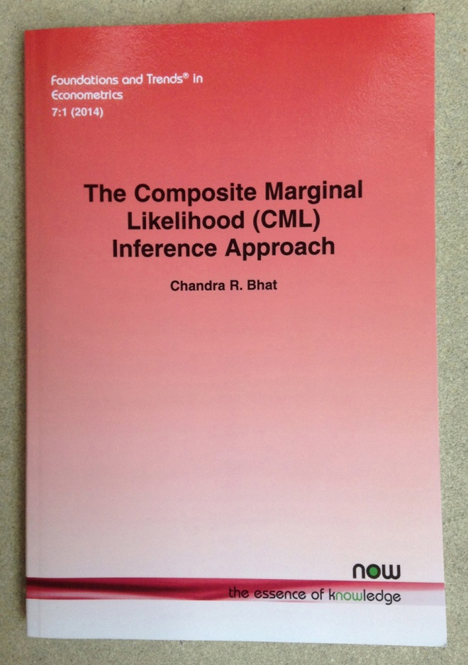

Slide 62
Panel MNP
10 different datasets created for each covariance structure
5 choice occasions; 500 individuals; 5 alternatives; 5 random variables
The MSL and MACML estimation procedures are applied to each data set.
For the MSL approach, simulation error ignored
The MACML estimator is applied to each dataset 10 times with different permutations

Slide 63
Panel MNP: Diagonal
 | MSL-250 Halton Draws | MACML
Mean APB | 17.1% | 8.0%
Mean Time for Convergence (min) | 96.26 | 12.35
S.D. of Time for Convergence | 11.13 | 3.01
% of Runs Conveyed | 90% | 100%
MSL-450 Halton Draws: APB 14.3% and Mean Time=186 mins

Slide 64
Panel MNP: Non-Diagonal
 | MSL-250 Halton Draws | MACML
Mean APB | 17.8% | 10.6%
Mean Time for Convergence (min) | 192.65 | 24.41
S.D. of Time for Convergence | 52.31 | 7.81
% of Runs Conveyed | 50% | 100%

Slide 65
Thank You!

Slide 66
Binary Choice Models
The choice set (C) contains only two alternatives.
Individual n chooses alternative i if and only if:
Since the analyst do not have full knowledge on decision making process:
i
j

Slide 67
j
i
Overall scale of utility is irrelevant!
Only differences in utility matters.
The absolute level of utility is irrelevant.
The alternative with the highest utility is the same no matter how utility is scaled.

Slide 68
j
i
Adding/subtracting a constant to/from both utilities does not affect the choice probabilities; only shifts the functions V_{in} and V_{jn} .

Slide 69
The mathematical form of a discrete choice model is determined by the assumptions made regarding the error terms of the utility function for each alternative.
Specific assumptions in binary choice models:
Error terms are identically and independently distributed across decision makers
Error terms are identically and independently distributed across alternatives
Assumptions above not needed really in binary case, but convenient when extending to multinomial logit case; also variances and covariance, even if present, cannot be identified (detail, not to worry now)
Two common assumptions for error distributions in the statistical and modeling literature:
Error terms are normal distributed Binary probit
Error terms are extreme-value (or Gumbel) distributed Binary logit

Slide 70
Similarly, multiplying each alternative’s utility by a positive constant does not affect the choice probabilities.
But, the variance of the error terms changes!
Normalize the variance of the error terms (same as normalizing the scale of utility)
for any λ>0

Slide 71
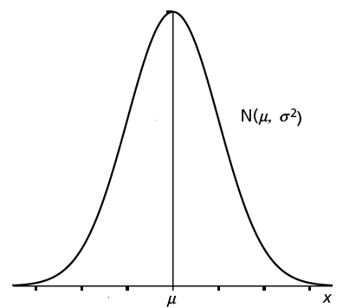
Binary Probit
Assume normal distribution for error terms ε_{DA,n} and ε_{TR,n}
Also, assume that all error terms have zero means (innocuous normalization)
“standard normal"

Slide 72
Get the standard normal by dividing the equation with standard deviation:
When we multiply the utility function with a constant λ, the probability remains the same!
Parameter estimates change (the coefficients are larger by a factor λ)
Notes:
The probability is always the same; we cannot estimate a variance since it can anything.

Slide 73
Binary Logit Model
Error terms are extreme-value (or Gumbel) distributed.
Independently and identically distributed error terms
The pdf and cdf functions for Gumbel G(0,θ):
Scale parameter that determines the variance of the distribution
For ease assume θ=1

Slide 74
Notes:
No integration; however in binary probit model we do not have closed form solution for choice probabilities, so integration is required

Slide 75
Utility Associated with the Attributes of Alternatives
Variables that describe the attributes of alternatives “V(X_{i})”
Influence utility of each alternative for all people in the population of interest
Service attributes: measurable and expected to influence people’s preferences/choices among alternatives
For instance, total travel time, in-vehicle travel time, out-of-vehicle travel time, travel cost, transfers required, walk distance, seat availability, etc. for mode choice modeling
Differ across alternatives for the same individual and also among individuals
Consider the differences in the origin and destination locations of each person’s travel in the context of mode choice modeling
Effect of attribute k on the utility of an alternative
Value of attribute k for alternative i

Slide 76
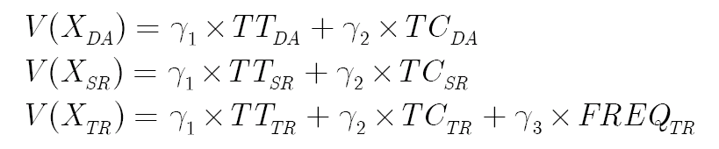
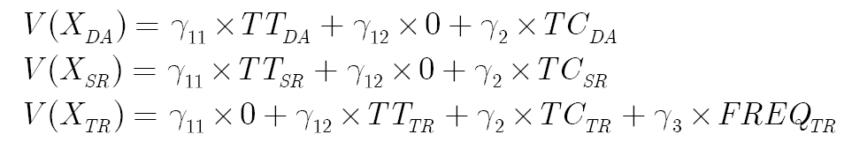
Generic: apply to all alternatives
Specific to transit only
Gamma parameters are identical for all alternatives to which they apply
Sensitivity to travel time and travel cost are identical across alternatives
But, different parameters can be estimated:

Slide 77
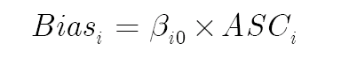
Utility ‘Biases’ Due to Excluded Variables
Decision makers exhibit preferences for alternatives which cannot be explained by the observed attributes of those alternatives
Alternative specific preference or bias
Measure the average preference of individuals with different characteristics for an alternative relative to a ‘reference’ alternative
Relative alternative does not influence the interpretation of the model results
Be careful: The alternative specific preference also adjusts for the range of sample values in estimation.
1 for alternative i and 0 for others

Slide 78
Utility Related to the Characteristics of the Decision Maker
“V(S_{n})” : The differences in ‘preferences’ across individuals can be represented by incorporating personal and household variables in choice models
For instance; age, gender, income, household vehicles, number of children in the household, etc.
Effect due to an increase in the m^{th} characteristic of the individual n
Value of the m^{th} characteristics for individual n
Differ across alternatives!

Slide 79
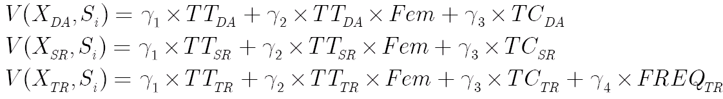
Utility Defined by Interactions between Alternative Attributes and Decision Maker Characteristics
“V(S_{n} ,X_{i})” : To take into account differences in how attributes are evaluated by different decision makers
For instance, in mode choice modeling
High income travelers may place less importance on travel cost
Divide the cost of travel of an alterative by annual income
Females may be more sensitive to travel time
Add a variable composed of the product of a dummy variable for female times travel time
Utility value of one minute of travel time to men
Additional utility value of one minute of travel time to women

Slide 80
Specification of the Additive Error Term
The analyst does not have any information about the error term
The total error term is the sum of errors
from many sources and is represented
by a random variable.
Sources of randomness:
Imperfect information
Measurement errors
Omission of model attributes
Omission of characteristics of the individual that influence his/her choice decision
Errors in the utility function
Different assumptions about the distribution of the random variables associated with the utility of each alternative result in different representations of the model used to describe and predict choice probabilities.

Slide 81


SESSION I
Choice Model Estimation Training
Prepared by Ipek N. Sener and Chandra R. Bhat
University of Texas at Austin
NCTCOG-University of Texas Partnership Program

